Slide 1

CRIME IN LA 2020- PRESENT

Slide 2

THE BASE OF OUR PROJECT WAS A DATA SET FROM DATA.GOV
CATALOG.DATA.GOV/DATASET/CRIME-DATA-FROM-2020-TO-PRESENT

Slide 3
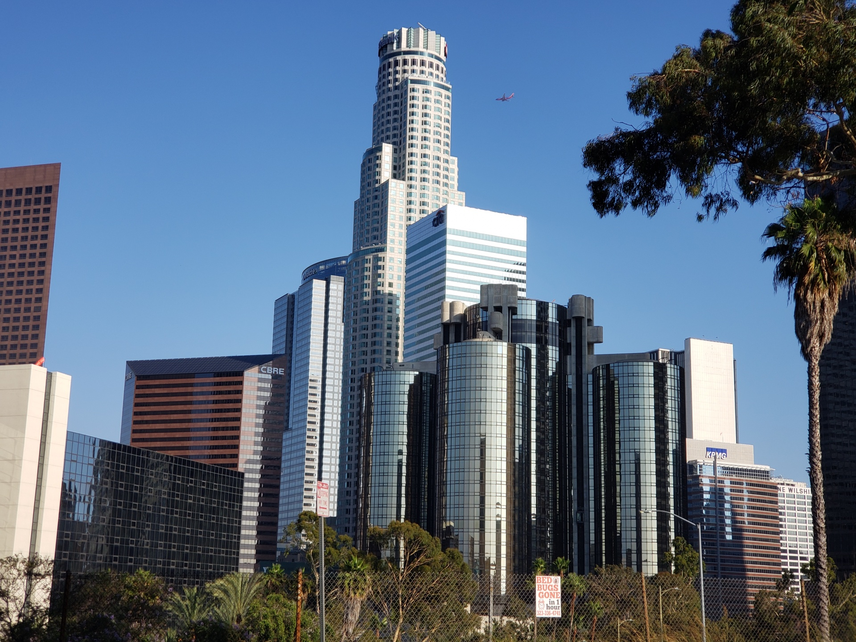
RESEARCH QUESTION
Our group looked at data from “Data.gov” on crimes reported in Los Angeles from 2020 to present day. Our goal is to decipher the data to figure out how dangerous Los Angeles is. Data was collected on 834,317 reported crimes.
The shape of original data was 834,320
rows and 28 columns. Cleared data has 290,925 rows and 14 columns

Slide 4

QUESTION 1
Demographics ( who are the victims of crimes, race, gender and age)
We found out that Hispanic people are most likely to be a victim of
crime. There is not a substantial difference between whether men or women are more likely to be a victim of a crime .The average age of victim is 35

Slide 5
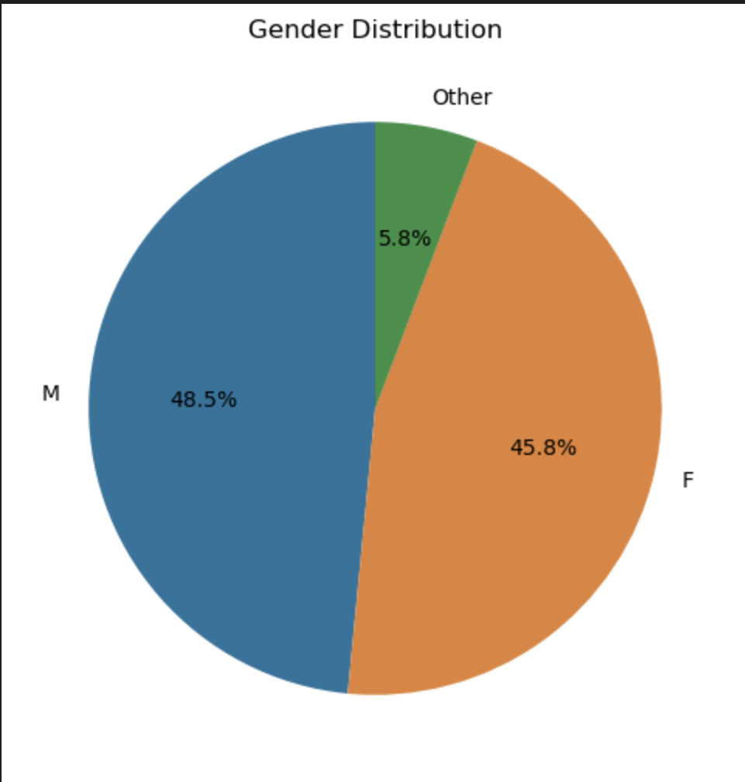
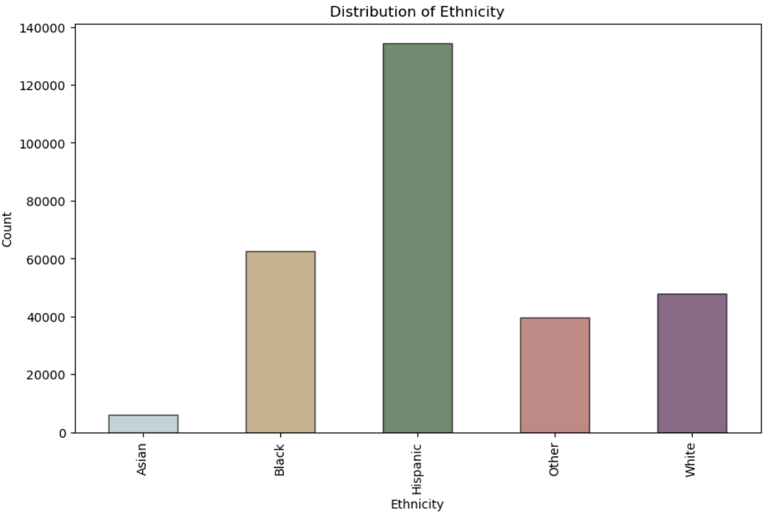
VICTIMS BY GENDER AND RACE GRAPH

Slide 6
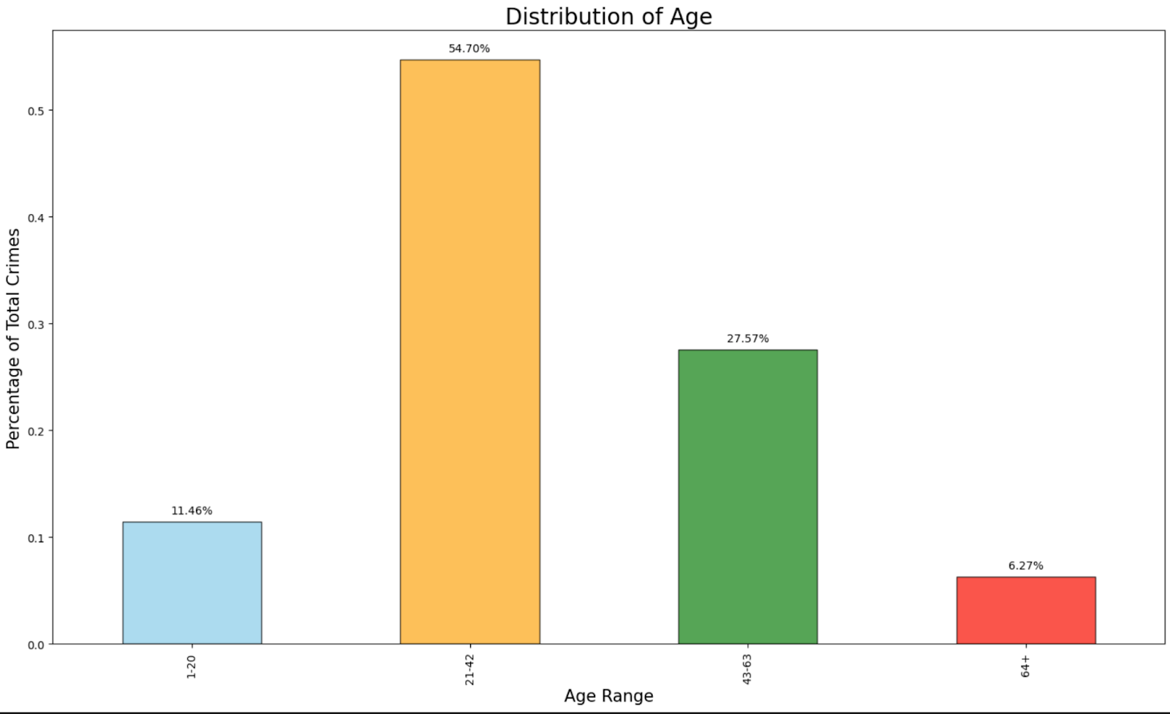
VICTIMS BY AGE

Slide 7


QUESTION 2
Location ( Where are the crimes being committed. Which neighborhoods/areas are most dangerous.)
Neighborhoods where the most crimes are being committed are located in south parts of
Los Angeles.
The most dangerous neighborhood according the data is 77Th street
Most of the crimes were reported in single family dwellings, multi-unit dwellings (apartment, duplex, etc)

Slide 8
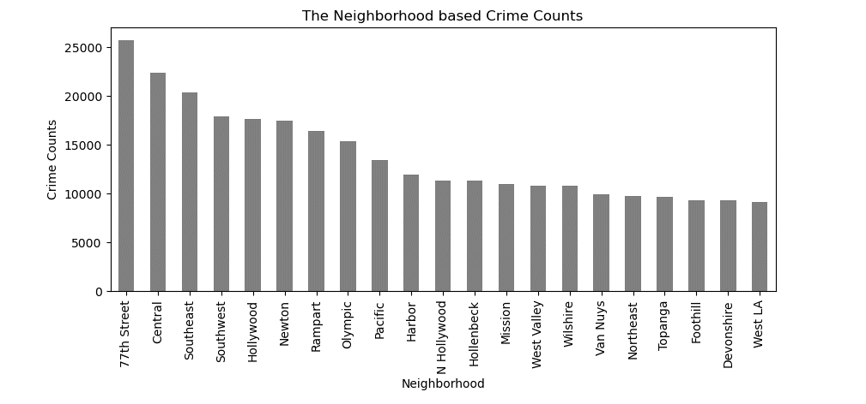
Crimes by Neighborhoods

Slide 9
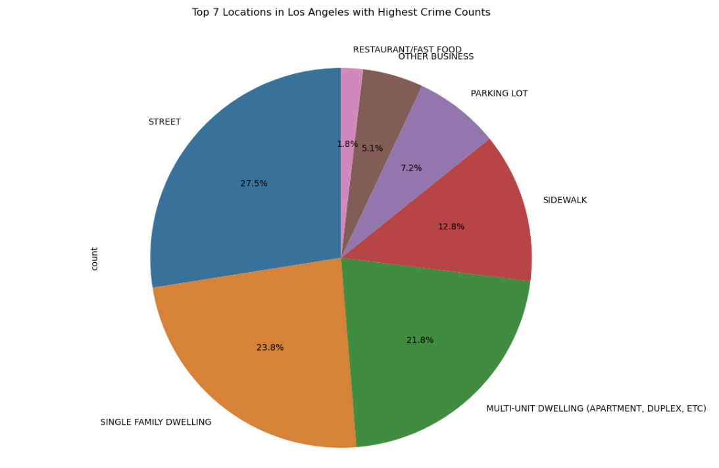
Places where crimes happen

Slide 10
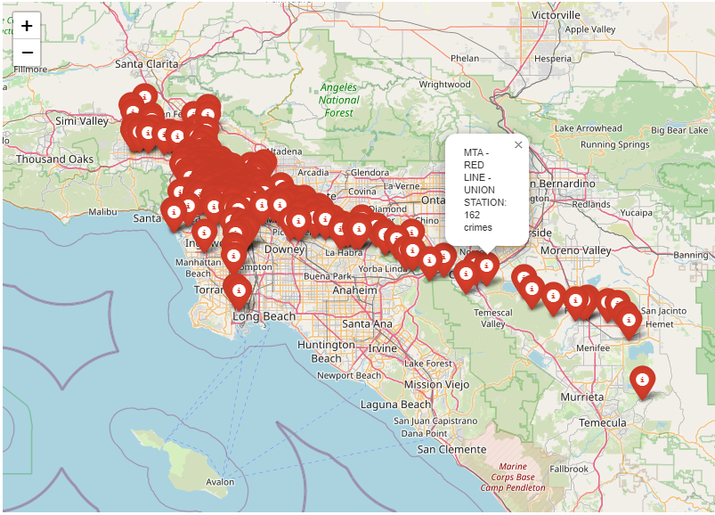
Map of crime in LA

Slide 11
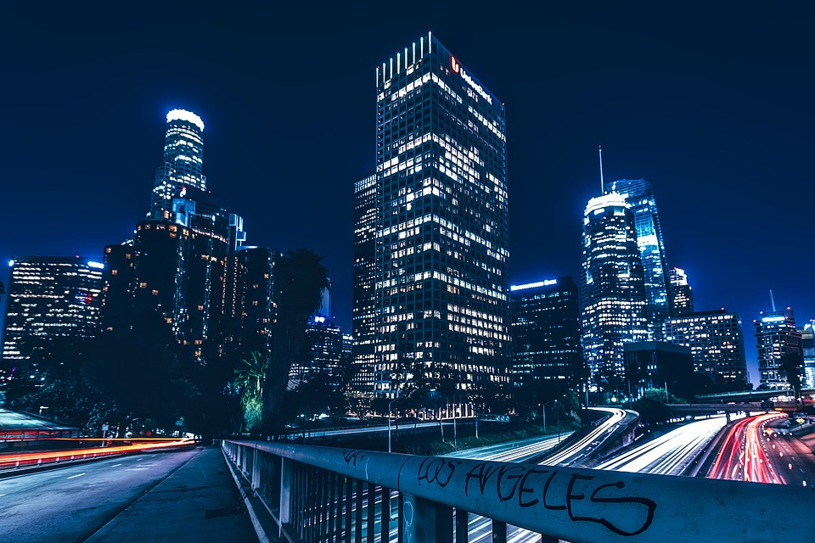
QUESTION 3
Type of crime ( weapons used and types of crimes committed)
According to data the most used
weapon is strong arm
Weapon Used Only Once
-M1-1 SEMIAUTOMATIC ASSAULT RIFLE
-HECKLER & KOCH 91
-SEMIAUTOMATIC ASSAULT RIFLE
-M-14 SEMI-AUTOMATIC ASSAULT RIFLE

Slide 12
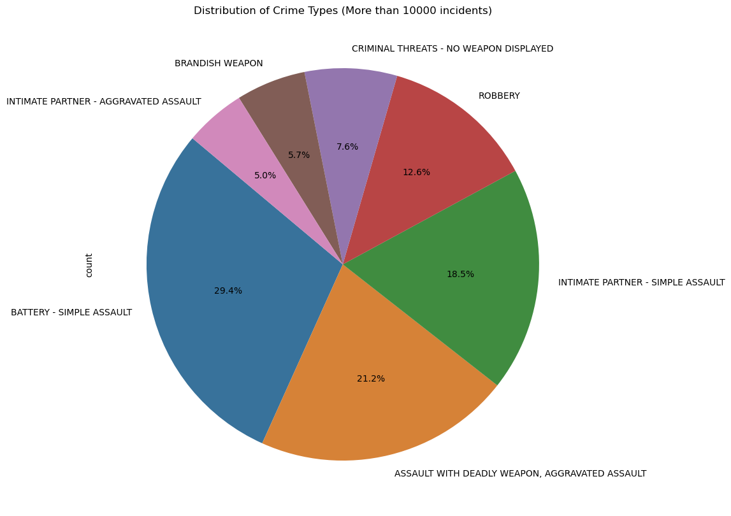
DISTRIBUTION OF CRIME TYPES (MORE THAN 10000 INCIDENTS)

Slide 13
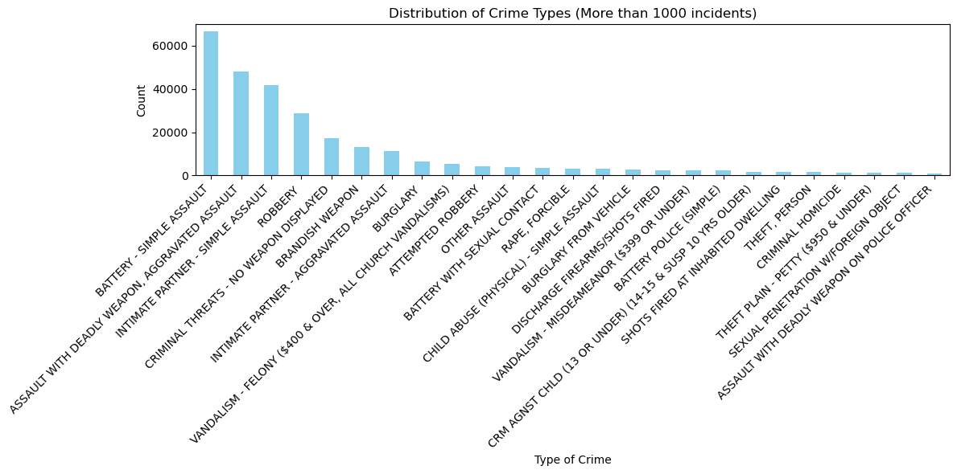
DISTRIBUTION OF CRIME TYPES (MORE THAN 10000 INCIDENTS)

Slide 14
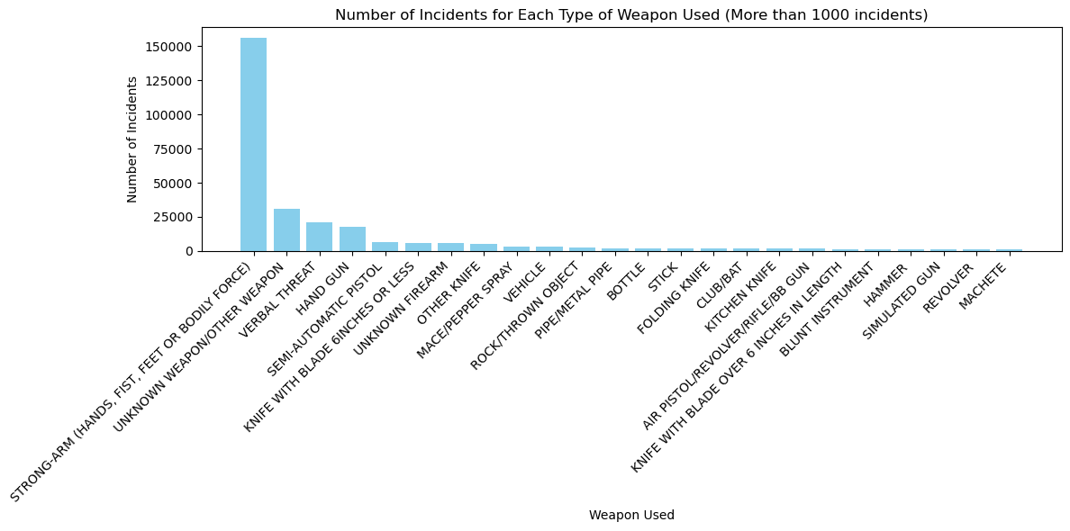
NUMBER OF INCIDENTS FOR EACH TYPE OF WEAPON USED (MORE THAN 1000 INCIDENTS)

Slide 15
QUESTION 4
Time ( When are the most crimes committed, time of day and month.)
Crime rates went up from 2020. Based on data the can say that June through October are the months with most committed crimes
Most of the crimes happen during the second part of the day, highest peak is 8pm

Slide 16
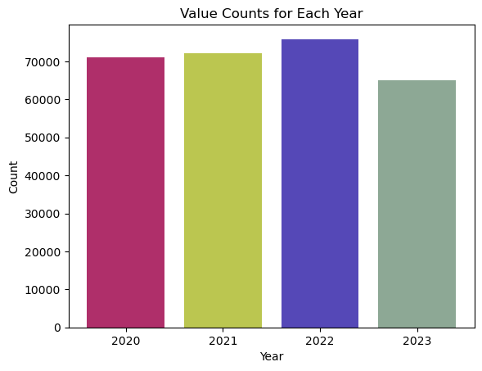
YEARLY DISTRIBUTION OF CRIMES
Notes:
We can see that crime rate are going up every year(mention that 2023 is not completed and missing november and december )

Slide 17
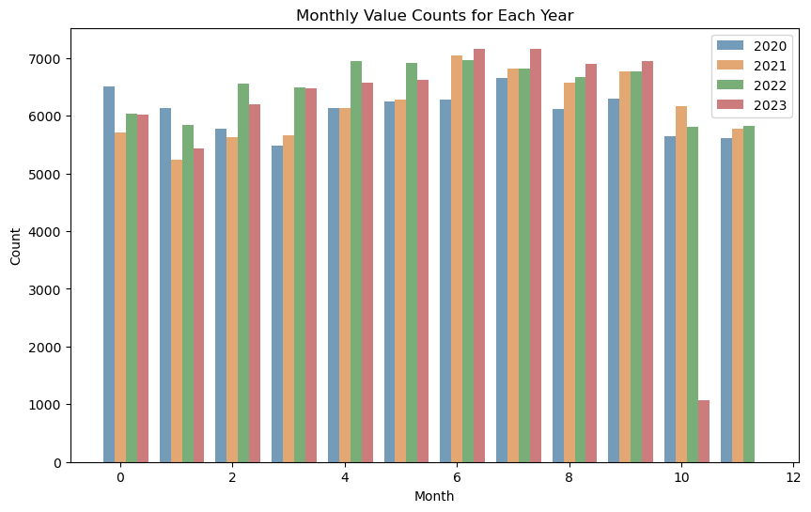
MONTHLY DISTRIBUTION OF CRIMES BY YEAR
Jan
Feb
Mar
Aprl
May
June
July
Aug
Sept
Oct
Nov
Dec
Notes:
I found out that more crimes happen in summer-fall time and less time in winter-fall(More tourist, more people outside because it’s warm)

Slide 18
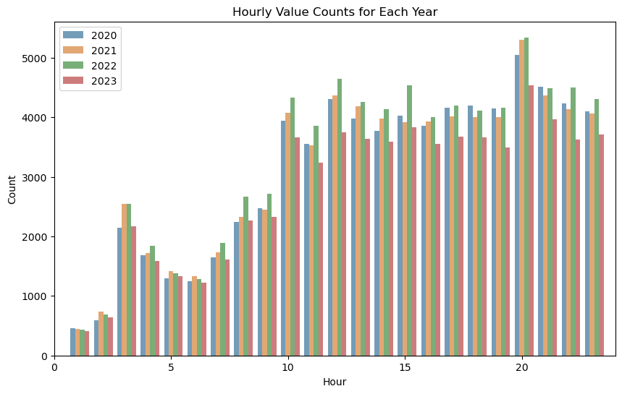
HOURLY DISTRIBUTION OF CRIMES BY YEAR

Slide 19
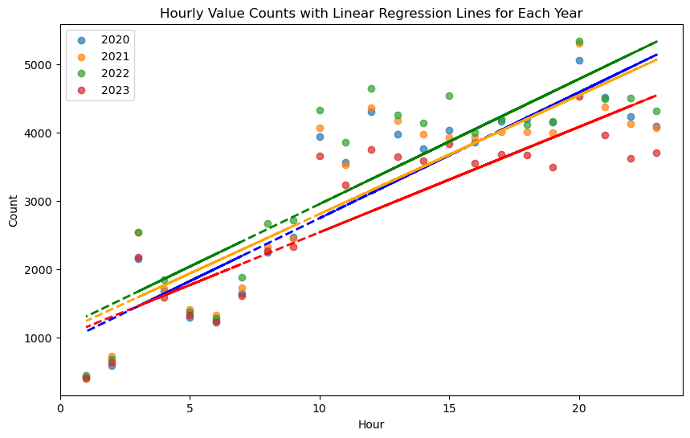
Linear regression for each year
Notes:
we can see how crime goes up in afternoon and evenings

Slide 20


Slide 21

THANK YOU

